Slide 1
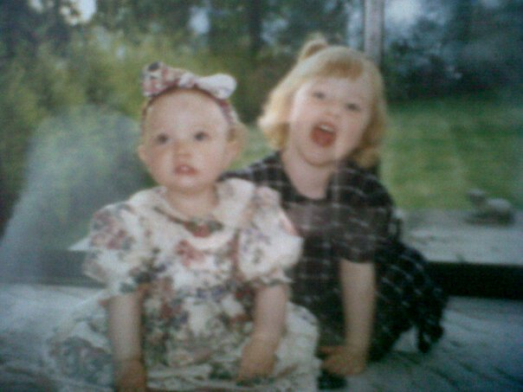
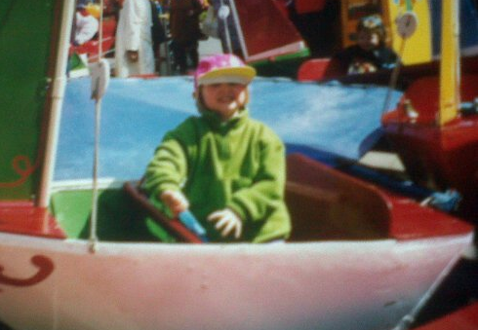
Child of God

Slide 2
Gobaith Môn
Gobaith Môn aims to bring together Christians from all denominations to bring Hope to the youth of the Island by encouraging and developing youth work in schools, churches and communities.

Slide 3
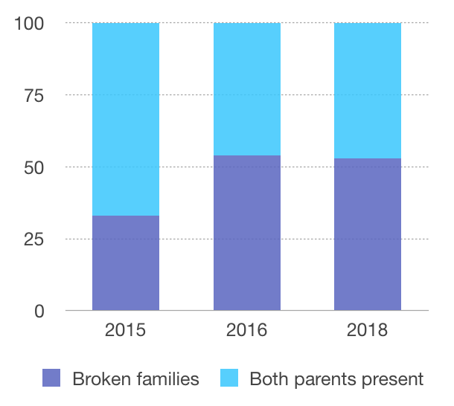
Notes:
Britain is facing a “crisis of fatherlessness” in which almost half of all children born today will not be living with both parents by the time they are 15,
2015- 33% identified as being from a broken home
2016- 54% identified as being from a broken home
2018- 53% identified as being from a broken home
They understand the need for both parents and they are hurt by their experience

Slide 4
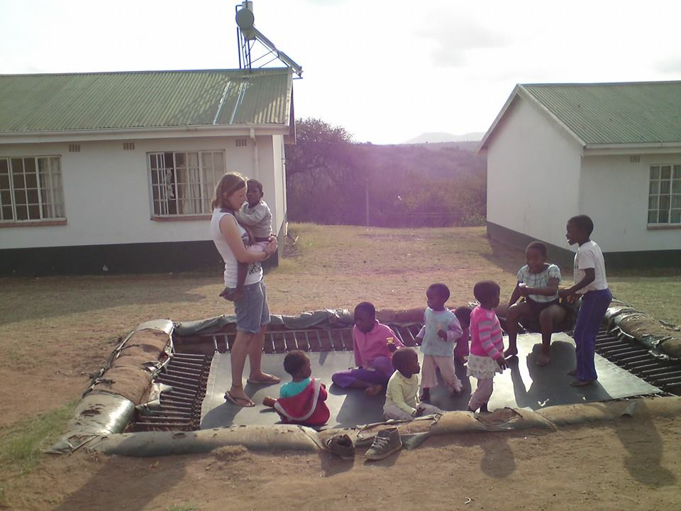
Notes:
Identity
Stories of when people have insulted me

Slide 5
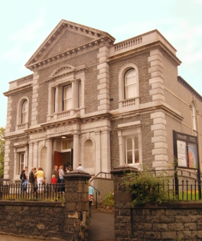
Notes:
Organisations vs church
An organisation agrees on everything, and if you don’t agree your out. But God does not operate as a dictator but as a father and the church are his children.
The family of God should be inclusive not exclusive.
People crave community, we were made to belong. We want to be a part of something bigger than ourselves, whether it is a hobby or a club.
Part of what makes us human is our need to BELONG
Identity issues can arise if we don’t feel like we belong

Slide 6
3 26…for in Christ Jesus you are all sons of God, through faith. For as many of you as were baptized into Christ have put on Christ.

Slide 7
There is neither Jew nor Greek, there is neither slave nor free, there is no male and female, for you are all one in Christ Jesus. And if you are Christ's, then you are Abraham's offspring, heirs according to promise.

Slide 8
4 I mean that the heir, as long as he is a child, is no different from a slave, though he is the owner of everything, but he is under guardians and managers until the date set by his father. In the same way we also, when we were children, were enslaved to the elementary principles of the world.

Slide 9
But when the fullness of time had come, God sent forth his Son, born of woman, born under the law, to redeem those who were under the law, so that we might receive adoption as sons. And because you are sons, God has sent the Spirit of his Son into our hearts, crying, “Abba! Father!”

Slide 10
So you are no longer a slave, but a son, and if a son, then an heir through God.
Formerly, when you did not know God, you were enslaved to those that by nature are not gods. But now that you have come to know God, or rather to be known by God, how can you turn back again to the weak and worthless elementary principles of the world, whose slaves you want to be once more?
Notes:
Sons of Abraham-Abraham was a man who was told that through him ALL nations will be blessed. So as a child of Abraham we inherit the blessing promised to Abraham if we live by faith, not just for jews.
Sonship- some translations don’t like the idea of it saying sonship over children of God but in the same way the church as the bride doesn’t goes for both genders so does sonship. In the context of the bible telling them they are sons would mean they are entitled to the inheritance as a son of God
Elementary principles

Slide 11
Notes:
When we look at trees
Leaves = Thing that are external
Our external things could be

Slide 12
Financial status
Work (job, school, uni)
Hobbies
Friendships and relationships
Church/ ministry/ Christian stuff
Family
Notes:
Slave to the world
Belief System = roots
our basic beliefs
what makes us think implication-ally —> the more we know the more we are able to articulate what we think because we know what we believe and why we believe it
this is shaped by the world which we grow up in and the people we surround ourselves by
What would being rooted in our culture/ the world look like?
Idol of self/ Selfishness- I believe that every feeling I have should be acted on no matter the consequences.
I would eat mcdonalds everyday if it wasn’t bad for me. Giving in to our every desire is not good for us or the people around us.
Fear of not being successful- If we don’t understand that our value comes from being a child of God then we will constantly be trying to find value for ourselves. Therefore, if we do not succeed in our job/ family/ hobbies we feel insecure and unworthy. We believe our next success will give us that value we desire.
Madonna says- ‘My drive in life comes from a fear of being mediocre. That is always pushing me. I push past one spell of it and discover myself as a special human being but then I feel I am still mediocre and uninteresting unless I do something else. Because even though I have become somebody, I still have to prove that I am somebody. My struggle has never ended and I guess it never will’.
No absolute truth- Uncertainty breeds anxiety. When people are rooted in the fact that there is no truth they will begin to make up their own truth about things. Using our own morals as guidance to what is right and wrong. However, if we are to live without truth there will be implications.
Traffic light example.
Trunk = Values
our values come out from what we believe in
What are the values of being rooted in culture/ world?
Others opinion/ image
Own morality/ judgement
Creating value for themselves
So then what do our external things look like if we are rooted in the world…
Family and relationships Pressure on family and relationships to look successful
Financial status Believing you’ll be happy once you’re earning a certain amount but always striving for more
Work/ school Anxiety in work to do well ‘work is meant to serve you not you serve work’
Hobbies throwing yourself into a hobby and finding your identity in that. But what happens when thats not possible. (Swimming in Bradford)
Church/ Ministry/ Christian stuff If we are trying to do this in our own strength it wont fail immediately but sooner or later the storms will come and the whole thing will fall apart.
Fear of failure so never taking a risk
Add rhetorical question- slow down

Slide 13
Financial status
Work (job, school, uni)
Hobbies
Friendships and relationships
Church/ ministry/ Christian stuff
Family
Notes:
Slave to religion
“The religious person is as lost as the irreligious person” Tim Keller
Being rooted in religion is a dangerous place to be. We see in the story of the prodigal son that the very moral son who stayed with his father and worked for him didn’t join in with the party in the end. They both wanted the fathers inheritance but not the father. But the prodigal son knew how far away he was from the father came back and repented, his brother didn’t he stayed out in anger.
What would being rooted in the law/religion?
Insecure in their relationship with God- never really know where they stand.
Next slide

Slide 14
“Christians who are no longer sure that God loves and accepts them in Jesus, apart from their present spiritual achievements, are subconsciously radically insecure persons, much less secure than non-Christians, because of the constant bulletins they receive from their Christian environment about the holiness of God and the righteousness they are supposed to have. Their insecurity shows itself in pride, a fierce defensive assertion of their own righteousness and defensive criticism of others. They cling desperately to legal, pharisaical righteousness, but envy, jealousy and other … sin grow out of their fundamental insecurity.” (Dynamics of Spiritual Life, pages 211-212)”

Slide 15
Financial status
Work (job, school, uni)
Hobbies
Friendships and relationships
Church/ ministry/ Christian stuff
Family
Notes:
Ego- believing that we can earn favour with God and because of their good works God accepts us
Fear and reward- if we are motivated by fear we will change for a little while but it wont last. If we are motivated by reward we will change for a little while but it wont last. We need to be motivated by grace. What has already been done.
What are the values of being rooted in religion?
Value morality- however, we know that the pharisees lacked grace and love
Value works like church attendance, ministry and bible reading
Value programmes over relationship
So then what do our external things look like if we are rooted in the world…
Family and relationships Pressure on family and relationships to look successful, to look like the perfect christian family
Financial status accept God when things are going well but question God when things don’t go right for them- they haven’t got to know his character so they don’t know if he is trustworthy
Work/ school work hard but are constantly needing affirmation
Church/ Ministry/ Christian stuff think this is getting them closer to God. We get annoyed when people who we consider to be less spiritual than them seem to be blessed by God
Add rhetorical question- slow down

Slide 16
But the fruit of the Spirit is love, joy, peace, patience, kindness, goodness, faithfulness, gentleness, self-control; against such things there is no law.

Slide 17
Financial status
Work (job, school, uni)
Hobbies
Friendships and relationships
Church/ ministry/ Christian stuff
Family
Notes:
Being rooted in our identity as a child of God
Having God as a father- being secure in the fact that we are loved by God, that he pursues a love relationship with us. Knowing we are accepted and belong to his family.
Knowing Jesus as a saviour, friend and Lord.
Allowing the spirit to work in and through us.
Being rooted in Gods word- what it says about God and what it says about us. Allowing it to be the loudest voice in our life. Understanding it as a basis of our morality, value and worth.
Root ourselves in Gods truth. Believing his promises are true and that he is faithful.
What are the values of being rooted in our identity as a child of God?
Value people- not what they think about us but valuing them because you love them.
Value church attendance, ministry and bible reading because it bring us closer to God.
Value what God has given us and want to honour God in those things understanding that we haven’t earned it but God has blessed us.
So then what do our external things look like if we are rooted in the child of God…
Family and relationships loving, kind, faithful in the good times and the bad
Financial status doesn’t mean your financial situation will always be good, it means you will have peace
Work/ school patient in work with colleagues and stress, you will have self control in different situations.
Church/ Ministry/ Christian stuff you will have joy in working for God, not out of obligation but because Gods love is flowing through you.
Add rhetorical question- slow down

Slide 18
How?
- Read the bible
- Spend time with Gods people
-Be vulnerable and accountable
- Be intentional
Notes:
We need to de-root from the world and religion
Chopping off the branches- it grows back- anxiety
Chopping off the trunk- grows back- value of control/ others
De-rooting and being rooted in God- kills it and new life is created.- word of God
Might not know what the root is, no opportunity to process thing. Talk to people

Slide 19
Who are we going to be?
Slave to the World
Slave to Religion
Child of God
Notes:
Emotionally healthy spirituality Peter Scazzero

