Slide 1
“The name of the LORD is a strong tower; the righteous run to it and are safe.
The wealth of the rich is their fortified city; they imagine it an unscalable wall.”
Prov. 18:10-11
(NIV 1984)

Slide 2
“Out of the depths I cry to you, O LORD; O Lord, hear my cry…”
Psalm 130:1-2a (NIV 1984)

Slide 3
Lord = אֲדֹנָי‎ (Adonai)
LORD = יהוה‎ (YHWH)

Slide 4
Y CN PRBBLY RD THS
SNTNC WTH TH VWLS
LFT T
(U I OE IOU E OOA I OEA AE)
Notes:
You can probably read this sentence with the vowels left out
(But this one without the consonants is somewhat harder)

Slide 5
“The shem of Hashem
is a strong migdal (tower)…”
Prov. 18:10a (OJB)

Slide 6
“God is our refuge and
strength, an ever-present
help in trouble…
The LORD Almighty is with us;
the God of Jacob is our fortress.”
Psalm 46:1, 7(=11) (NIV 1984)

Slide 7
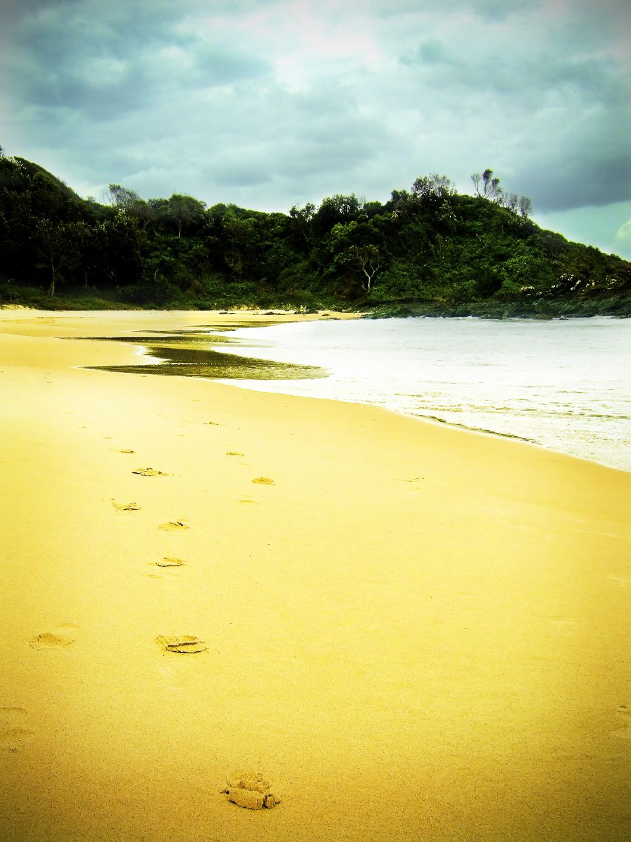
Notes:
Photo by Edward Lim, obtained from www.flickr.com under a Creative Commons licence. NB the footprints poem is by Mary Stevenson

Slide 8
“… I know whom I have believed, and am convinced that he is able to guard what I have entrusted to him…”
2 Timothy 1:12b (NIV 1984)

Slide 9
“The name of the LORD is a strong tower; the righteous run to it and are safe.
The wealth of the rich is their fortified city; they imagine it an unscalable wall.”
Prov. 18:10-11
(NIV 1984)

Slide 10
“And he told them this parable: ‘The ground of a certain rich man yielded an abundant
harvest. He thought to himself, “What shall I do? I have
no place to store my crops.” Then he said, “This is what
I’ll do. I will tear down my barns and build bigger ones,
and there I will store my surplus grain, and I’ll say to
myself, ‘You have plenty of grain laid up for many years.
Take life easy; eat, drink and be merry.’
But God said to him, “You fool! This very night your life
will be demanded from you. Then who will get what you
have prepared for yourself?”
This is how it will be with whoever stores up things for
themselves but is not rich towards God.’”
Luke 12:16-21 (NIV 2011)

Slide 11
“Now listen, you who say, ‘Today or
tomorrow we will go to this or that city,
spend a year there, carry on business
and make money.’ Why, you do not even
know what will happen tomorrow.
What is your life? You are a mist that
appears for a little while and then
vanishes.”
James 4:13-14 (NIV 2011)

Slide 12
“… give me neither poverty nor
riches, but give me only my
daily bread. Otherwise I may
have too much and disown you
and say ‘Who is the Lord?’. Or I may become poor and steal,
and so dishonour the name of
my God.”
Prov. 30:3b-9 (NIV 1984)

Slide 13
“Unless the Lord builds the house,
the builders labour in vain.
Unless the Lord watches over the city,
the watchmen stand guard in vain.”
Psalm 127:1 (NIV 1984)

Slide 14
“… everyone who calls
on the name of the Lord
will be saved.”
Joel 2:32/Acts 2:21 (NIV 1984)

Slide 15
“Prayer should be
our first resource,
not our last resort.”
Andrew Ollerton, sermon at Penrallt, 23/10/2016 (am)
Notes:
NB this quote is from memory, as the sermon was not recorded and we don’t have a transcript!

