Slide 1
“It was just before the Passover Festival. Jesus knew that the hour had come for him to leave this world and go to the Father. Having loved his own who were in the world, he loved them to the end.”
John 13:1 (NIV)

Slide 2
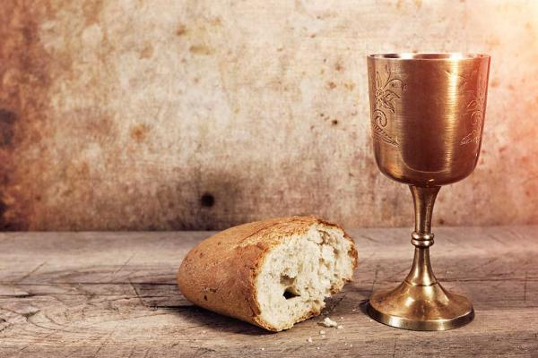
“…“I have loved you with an everlasting love; I have drawn you with unfailing kindness.” Jeremiah 31:3 (NIV)
“and walk in the way of love, just as Christ loved us and gave himself up for us as a fragrant offering and sacrifice to God.” Ephesians 5:2 (NIV)
The Love of Jesus Christ

Slide 3
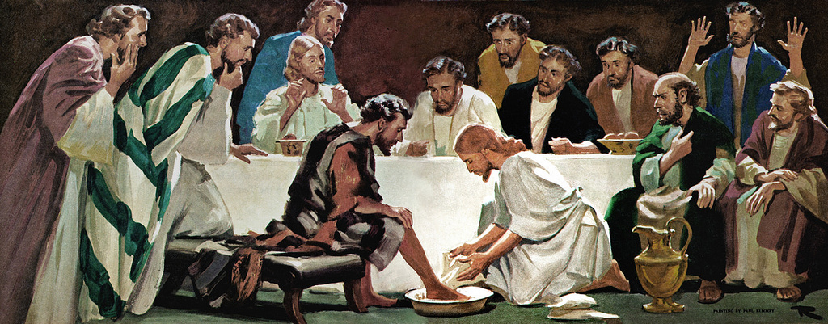
The Love of Jesus Christ

Slide 4
I. The Love of Jesus Christ is personal
“But God demonstrates his own love for us in this: While we were still sinners, Christ died for us.” Romans 5:8 (NIV)
Saint Augustine said;
“God loves us every one as though there were but one of us to love”

Slide 5
II. The Love of Jesus Christ is a universal love
John 3:16 (NIV)
“For God so loved the world that he gave his one and only Son, that whoever believes in him shall not perish but have eternal life”.

Slide 6
III. The Love of Jesus Christ is a powerful love
The love of Jesus Christ is powerful in seeking sinners:
Luke 19:10 (NIV)
“For the Son of Man came to seek and to save the lost.”

Slide 7
The Love of Jesus Christ is a demanding love
a) The love of our Lord demands my love
Exodus 20:4-5 (NIV)
“⁴ “You shall not make for yourself an image in the form of anything in heaven above or on the earth beneath or in the waters below. ⁵ You shall not bow down to them or worship them; for I, the Lord your God, am a jealous God...”

Slide 8
The Love of Jesus Christ is a demanding love
b) The love of Jesus Christ demands commandment keeping
“Jesus replied, “Anyone who loves me will obey my teaching. My Father will love them, and we will come to them and make our home with them”.
John 14:23 (NIV)

Slide 9
c) The love of Jesus Christ demands witness
¹⁵ When they had finished eating, Jesus said to Simon Peter, “Simon son of John, do you love me more than these?” “Yes, Lord,” he said, “you know that I love you.”Jesus said, “Feed my lambs.” ¹⁶ Again Jesus said, “Simon son of John, do you love me?” He answered, “Yes, Lord, you know that I love you.” Jesus said, “Take care of my sheep.” ¹⁷ The third time he said to him, “Simon son of John, do you love me?” Peter was hurt because Jesus asked him the third time, “Do you love me?” He said, “Lord, you know all things; you know that I love you.”Jesus said, “Feed my sheep.
John 21:15-17 (NIV)

Slide 10
V. The Love of Jesus Christ is a triumphant love
In Romans 8:37 the Apostle Paul says;
“…in all these things we are more than conquerors through him who loved us.”

Slide 11
“The greatest theological insight that I have ever had is this: Jesus loves me, this I know, for the Bible tells me so!”

Slide 12
No matter what your life has been like, He still loves you! How much do you love God?

Slide 13
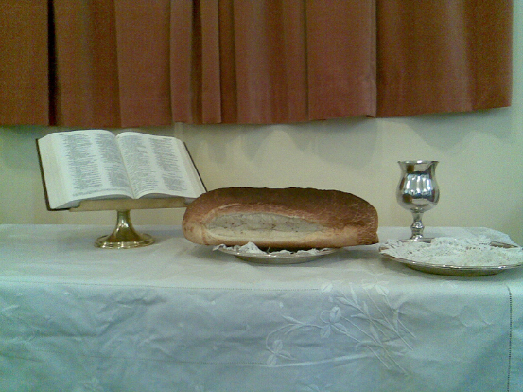
The Love of Jesus Christ
Therefore, my dear friends, …continue to work out your salvation with fear and trembling, for it is God who works in you to will and to act in order to fulfill his good purpose.
Philippians 2:12-13 (NIV)

Slide 14
I. The Love of Jesus Christ is personal
II. The Love of Jesus Christ is a universal love
III. The Love of Jesus Christ is a powerful love
IV. The Love of Jesus Christ is a demanding love
V. The Love of Jesus Christ is a triumphant love

